Slide 1
Welcome, Parents of the Class of 2023!

Slide 2
Agenda for the Evening
Welcome
9th Grade Transition Information
Graduation Requirements
College Entrance Information
Pathway Information
Pre-Registration Process
Future Dates and closing

Slide 3
What we know about 8th Grade to 9th Grade Transition….
Research has shown:
DECLINE in grades and attendance
DECREASE in self perception/esteem
WITH,
INCREASED need for friendships and social interaction

Slide 4
We also know…
Although 8th grade test scores are good predictors of student success in high school, ATTENDANCE is 8x more predictive of course failure.
And, students attend class more often when they have strong relationships with teachers and when they see school/coursework as relevant and important to their future.

Slide 5
High School Baseline Requirements

Slide 6
To Graduate…
Credits required: 230 credits
in required areas

Slide 7
College Entrance Requirements
a. History 2 years 1 year World History & 1 year U.S History
b. English 4 years
c. Mathematics 3 years (Alg 1, Geometry, Alg 2)
d. Science 2 years lab science 1 Physical Science & 1 Life Science
e. Foreign Language 2 years Same Language—3 years recommended
f. Visual or Performing Art 1 year Either a Visual or Performing Art
g. Elective 1 year

Slide 8
So, if a sense of belonging and coursework relevancy is crucial to student success, what is Bullard doing to help engage students?

Slide 9
We have…
Athletics
Performance Arts (Theater, Drama, Band, Choir)
Visual Arts (Ceramics, Art, Multimedia)
Mock Trial
Clubs
Computer Science Sequence
Pathways
Biomedicine
Business Marketing & Technology
Law & Social Justice

Slide 10
Bullard Pathways
Biomedicine
Business Marketing & Technology
Law & Social Justice

Slide 11
Bullard Pathways
Pathways are designed to engage students in curriculum that is relevant to their post secondary goals and aspirations.
Pathways follow a Linked Learning model
3 classes are “linked” for subject coherence and relevance
English/Science/Pathway Elective
Students choose to join a pathway in Pre-Registration visits by choosing the pathway elective
4 Year Course of Study
Students in pathways will have the opportunity to:
Participate in industry related field trips
Engage in industry job shadows & internships
Have the opportunity to take Advanced Placement and Dual Enrollment courses (class at the community college that give BOTH high school AND college credit)
Graduate with industry certifications

Slide 12
Biomedicine
The Biomedicine Pathway is designed:
* to expose students to a wide range of careers in the health care industry
* to build a strong knowledge base of anatomy & physiology
* to develop understanding of public health—including ways to affect community change
Elective: Principles of Biomedical Science

Slide 13
The Business Marketing & Technology Pathway is designed to: * teach students about marketing, sales & service * engage students with software and technology used in the business industry * develop website, graphic design and other multimedia skills in order to build a strong online presence for business. Elective: Multimedia
Business Marketing and Technology

Slide 14
Law & Social Justice
The Law & Social Justice Pathway is designed to:
* expose students to a wide range of careers in the public service industry (police, probation, social work, lawyers, judiciary system, etc)
* build a strong foundation of criminal and civil law
* develop an understanding of the legal and court system, including ways to affect change and advocate for those in their communities
* 2+2+3 Pipeline for the California Consortium of Law
Elective: Criminal Justice and Law

Slide 15
Computer Science
Courses designed to teach programming fundamentals
Preparing students for AP Exams in Computer Science
Elective: Computer Science & Software Engineering

Slide 16
Wawona Pre-Registation starts TOMORROW!
Wednesday, Februrary 13, 2019

Slide 17
Course Pre-Registration
All students who are pre- registered at Bullard have a personalized form listing:
Course placement for English, Math and Science based on FUSD criteria for placement
Electives ranked in order of preference from your student’s choices online.

Slide 18
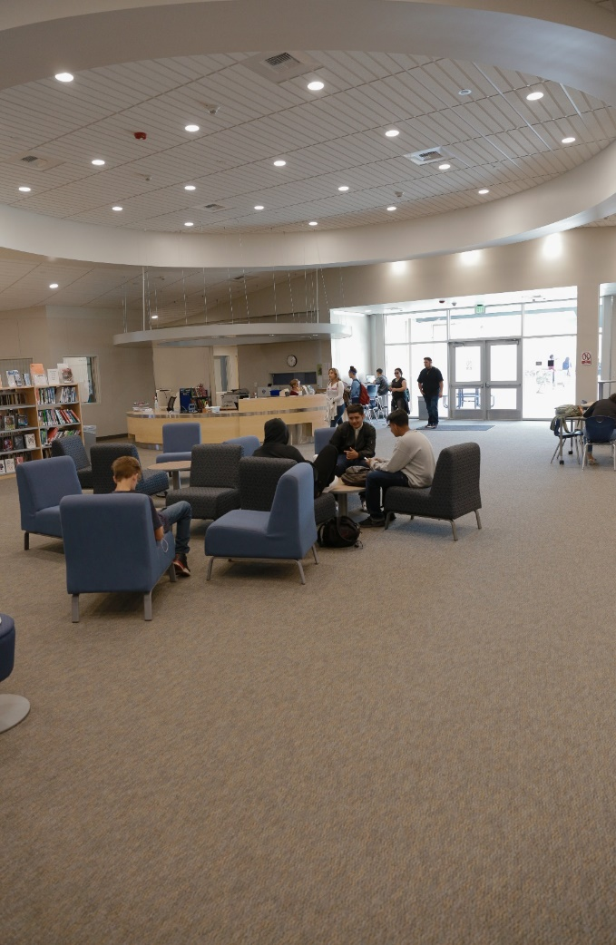
Pre-Registration Process…
Your student will visit Bullard on Wednesday or Thursday of this week.
Pathway/Elective option showcase in the quad
Your student will select 5 elective courses (ranked 1-5)

Slide 19
9th Grade Student Schedule
English
English 1, English 1G
Math
Algebra, Geometry, Geometry G
Science
Biology, Biology G
PE
PE, Athletic PE (as directed by coach),
Co-Curricular PE (Band PE—0 period)
2 Electives
Foreign Language, Pathway Elective, Forensics,
Visual & Performing Arts, AP Human Geography
Notes:
Shelby

Slide 20
Visual and Performing Arts Electives
Concert Choir
Beginning Women’s Choir
Piano I
Percussion Ensemble
Wind Ensemble
Brass Ensemble
Symphonic Orchestra
Jazz Band
Art I
Ceramics I
Theatre I
Multimedia
Band Aux (Color Guard)
Yearbook

Slide 21
Foreign Language
German I, II, III
Spanish I, II, III
Spanish Native Speakers I, II
Hmong Heritage I, II

Slide 22
Counselors will review end of the semester grades and summer grades and adjust the students’ schedules accordingly.
Transcript Review (Summer 2019)

Slide 23
But what can I do NOW to help my student get ready for next year?
Enroll in EDUTEXT
Join Remind.Com
Talk to your student NOW about their potential pathway interests
Engage in goal setting with your student--
Encourage your student to think about participating in athletics and clubs.
Set Attendance/Grade goals for the 1st semester
Enroll your student in a SUMMER program at BULLARD this year! (see Tenaya admin)
SUMMER BRIDGE
Pre-AP

Slide 24
Tuesday, June 11th
thru
Thursday, July 11th

Slide 25
Save the Date!
Open House Showcase at Bullard
March 11, 2019 at 5:30pm
8th Grade parents are invited to attend and:
See what your student registered for
Meet the Pathway Teachers
Walk the campus---visit classrooms
Learn about college entrance requirements
Get a better understanding of AP courses
Get dates for LINK Crew orientation (mandatory)

Slide 26
For updates and information join Remind.Com Bullard High Class of 2023
Text @couns2023 to 81010

Slide 27
Additional Questions?
BHSGuidance.org
Follow us on Twitter @BullardGuidance

